Slide 1
HAND TRACKING USING OPENCV
M.ADITYA VAMSI – SC11B094
S.SAI SRINIVAS – SC11B120

Slide 2
INTRODUCTION
Video tracking is the process of locating a moving object over time using a camera.
It has a variety of uses such as human-computer interaction, security and surveillance, video communication and compression, traffic control.
Contour tracking is used in detection of object boundary. Contour tracking methods iteratively evolve an initial contour initialized from the previous frame to its new position in the current frame.

Slide 3
SOFTWARES USED
Laptop webcam
Open CV libraries
Microsoft visual studios

Slide 4
PSUDEO ALGORITHM
Image capture
Finding mean
Skin detection
contour tracking
Edge detection
Contour detection

Slide 5
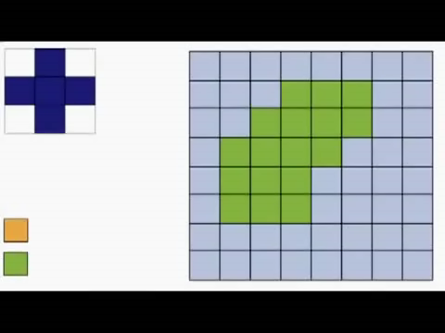
DILATION
Dilation is one of the basic operations in mathematical morphology. Originally developed for binary images, it has been expanded first to grayscale images, and then to complete lattices.
The dilation operation usually uses a structuring element for probing and expanding the shapes contained in the input image.

Slide 6
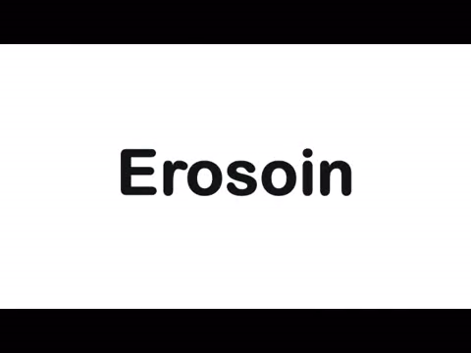
EROSION
Erosion is one of two fundamental operations (the other being dilation) in morphological image processing from which all other morphological operations are based.
It was originally defined for binary images, later being extended to grayscale images, and subsequently to complete lattices.

Slide 7
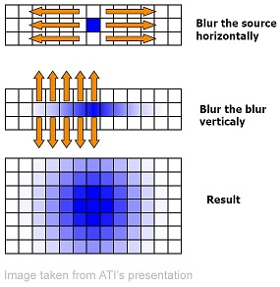
GAUSSIAN BLURING
A Gaussian blur is also known as Gaussian smoothing is the result of blurring an image by a Gaussian function.
It is a widely used effect in graphics software, typically to reduce image noise and reduce detail.

Slide 8
ALGORITHM
Image capturing by webcam
Gaussian blurring
BGR 2 HSV
Canny edge detection
Thresholding
Dilation
Tracking
&
Display images
Dilate
Erode
Finding largest contour
Erode
Dilate
Calculating mean postion

Slide 9
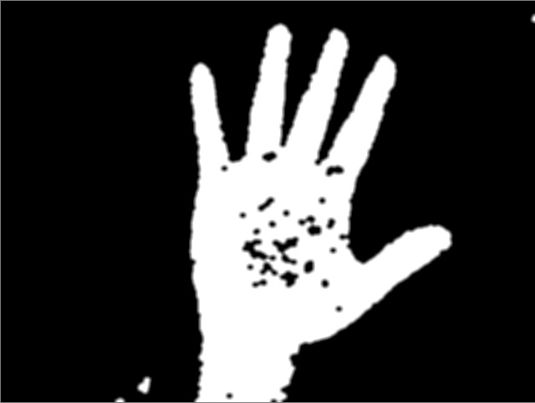
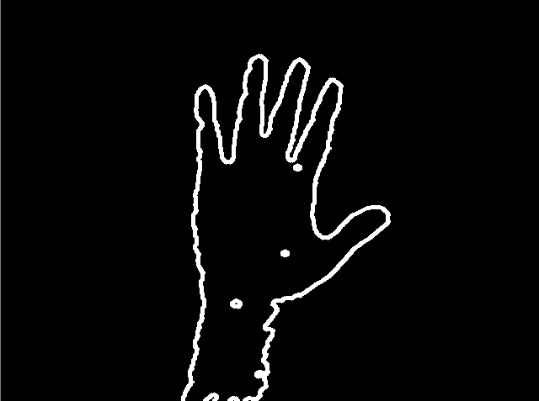
Binary image after skin detection contour of hand

Slide 10
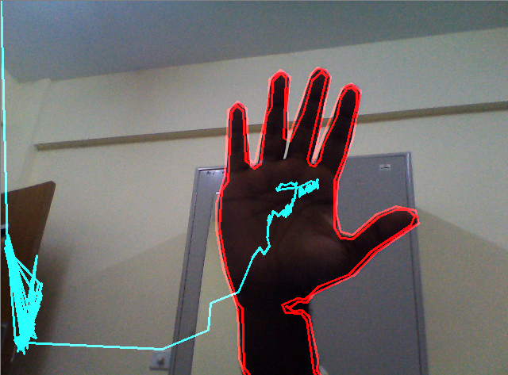
Real time image
Center of contour is detected
Motion of the image is detected by line joining the center of contour tracking.

Slide 11
THANK YOU

